Slide 1
Dynamic programming: Matrix Chain Multiplication
Session 16
Henry Lucky, S.Kom. M.Kom.

Slide 2
Outline Materials
Session 04
Matrix chain multiplication problem
Solving matrix chain multiplication problem
Elements of dynamic programming

Slide 3
Learning outcomes
LO 1: Explain fundamental concept of analysis algorithms
LO 2: Apply algorithm techniques and methods
LO 3: Solve a problem using specific algorithm.
LO 4: Compare several algorithm design methods

Slide 4
Matrix chain multiplication problem
Given a sequence (chain) (A1, A2, …, An) of matrices to be multiplied, where the matrices aren’t necessarily square, the goal is to compute the product A1A2…An.
A product of matrices is fully parenthesized if it is either a single matrix, or a product of two fully parenthesized matrix product, surrounded by parentheses.
For example, if the chain of matrices is (A1, A2, A3, A4), then you can fully parenthesize the product in five distinct ways:
(A1 (A2 (A3 A4))),
(A1 ((A2 A3) A4)),
((A1 A2) (A3 A4)),
((A1 (A2 A3)) A4),
(((A1 A2) A3) A4)

Slide 5
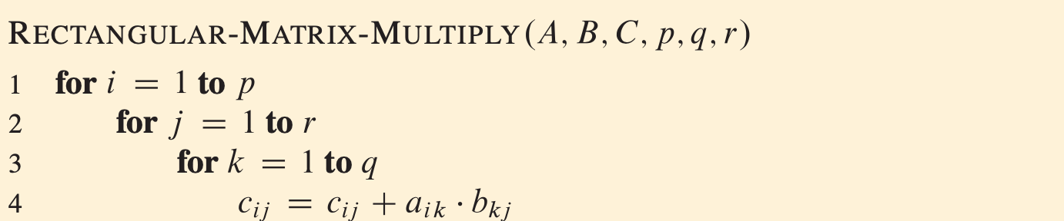
Matrix chain multiplication problem
The running time is dominated by scalar multiplication in line 4, which is pqr.

Slide 6
Matrix chain multiplication problem
When we chain multiplication on (A1, A2, A3), consider this example:
A1 is 10X100
A2 is 100X5
A3 is 5X50
If we put the parenthesis like ((A1 A2) A3), then it takes 10 X 100 X 5 + 10 X 5 X 50 = 5000 + 2500 = 7.500 scalar multiplications.
If the parenthesis is (A1 (A2 A3)), then it takes 100 X 5 X 50 + 10 X 100 X 50 = 25000 + 50000 = 75.000 scalar multiplications.
Thus, computing the product according to the first parenthesization is 10 times faster.

Slide 7
Matrix chain multiplication problem
Checking all possible parenthesizations is not an efficient algorithm.
Denote the number of alternative parenthesizations of a sequence of matrices by P(n)
(Catalan numbers)
The number of solutions is thus exponential in n.

Slide 8
Solving matrix chain multiplication problem
Step 1: The structure of an optimal parenthesization

Slide 9
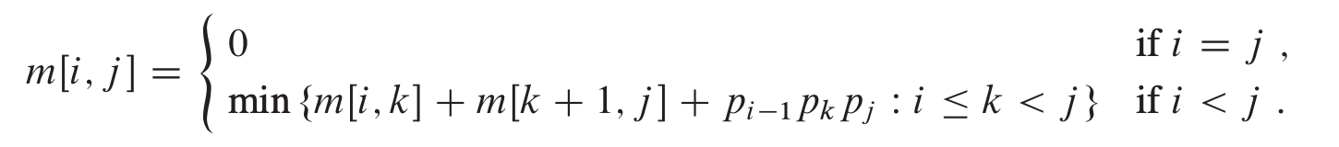
Solving matrix chain multiplication problem
Step 2: A recursive solution
Define m[i, j] = minimum number of scalar multiplications needed to compute the matrix Aij = Ai Ai+1…Aj
Our goal is m[1, n] as the lowest cost.

Slide 10
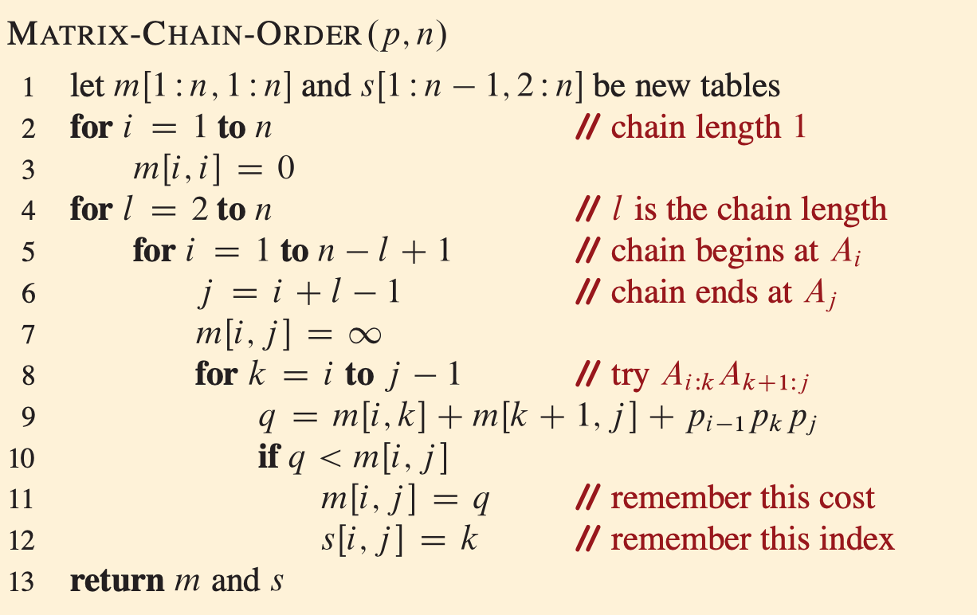

Solving matrix chain multiplication problem
Step 3: Computing the optimal costs
The running time is $O(n^{3})$, making it more efficient than counting the parenthesizes.

Slide 11
Solving matrix chain multiplication problem

Slide 12
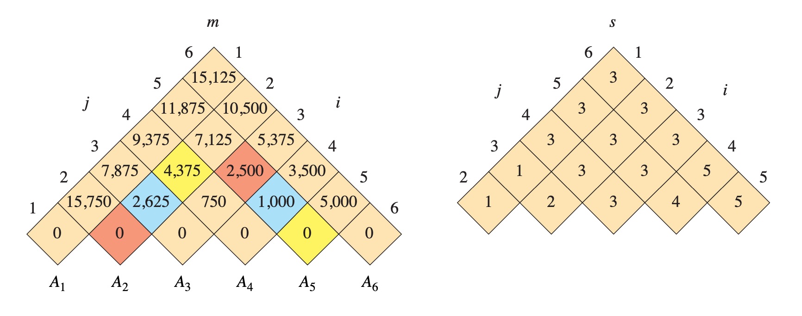
Solving matrix chain multiplication problem
The minimum number of scalar multiplications to multiply the 6 matrices is m[1,6] = 15,125.

Slide 13
Solving matrix chain multiplication problem
Of the entries that are not tan, the pairs that have the same color are taken together in line 9 when computing
m[2,5] = min{
m[2,2]+m[3,5]+p₁p₂p₅=0+2500+35×15×20=13000,
m[2,3]+m[4,5]+p₁p₃p₅=2625+1000+35×5×20=7125,
m[2,4]+m[5,5]+p₁p₄p₅=4375+0+35×10×20=11374
}
= 7125

Slide 14
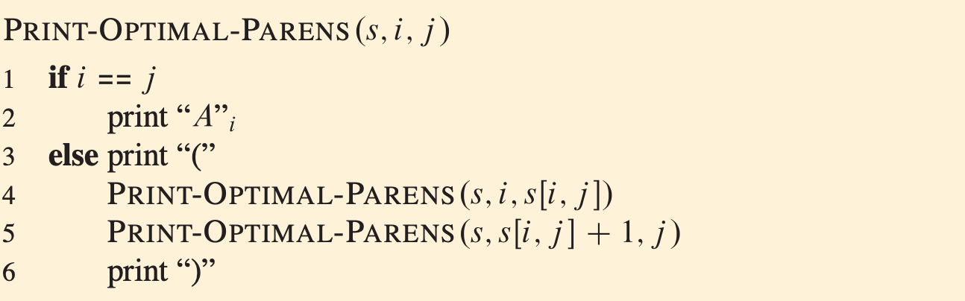
Solving matrix chain multiplication problem
Step 4: Constructing an optimal solution
To show directly how to multiply the matrices, we make a procedure
From the example before, if we call PRINT-OPTIMAL-PARENS(s, 1, 6), it will print the optimal parenthesize ((A1 (A2 A3)) ((A4 A5) A6))

Slide 15
Elements of dynamic programming
Optimal substructure
We say that a problem exhibits optimal substructure if an optimal solution to the problem contains within its optimal solution to subproblems.
Example: Matrix-multiplication problem

Slide 16
Elements of dynamic programming
Optimal substructure
You show that a solution to the problem consists of making a choice, Making this choice leaves one or more subproblems to be solved.
You suppose that for a given problem, you are given the choice that leads to an optimal solution.
Given this choice, you determine which subproblems ensue and how to best characterize the resulting space of subproblems.
You show that the solutions to the subproblems used within the optimal solution to the problem must themselves be optimal by using a “cut-and-paste” technique.

Slide 17
Elements of dynamic programming
Optimal substructure
Optimal substructure varies across problem domains in two ways:
How many subproblems are used in an optimal solution to the original problem, and
How many choices we have in determining which subproblem(s) to use in an optimal solution.

Slide 18
Elements of dynamic programming
Subtleties
One should be careful not to assume that optimal substructure applies when it does not. consider the following two problems in which we are given a directed graph G = (V, E) and vertices u, v ∈ V.
Unweighted shortest path:
Find a path from u to v consisting of the fewest edges. Good for Dynamic programming.
Unweighted longest simple path:
Find a simple path from u to v consisting of the most edges. Not good for Dynamic programming.

Slide 19
Elements of dynamic programming
Overlapping subproblems
For dynamic programming to be useful, the recursive algorithm should require us to compute optimal solutions to the same subproblems over and over again, because in this case, we benefit from just computing them once and then using the results later.
In total, there should be a small number of distinct subproblems (i.e. polynomial in the input size), even if there is an exponential number of total subproblems.
Note that in the divide-and-conquer algorithms we saw earlier in the class, the number of subproblems gets exponentially larger on each level of the recursion tree, but the size of the subproblems gets exponentially smaller.
In these dynamic programming algorithms, the number of distinct subproblems should be polynomial, but the size of the subproblems might decrease by 1 every time.

Slide 20
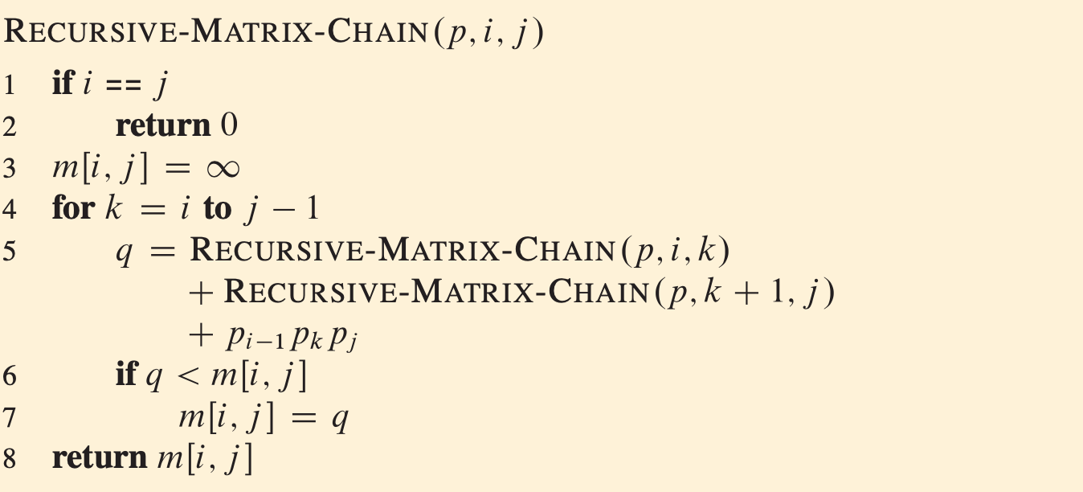
Elements of dynamic programming
Overlapping subproblems
Let’s consider MATRIX-CHAIN-MULTIPLICATION

Slide 21
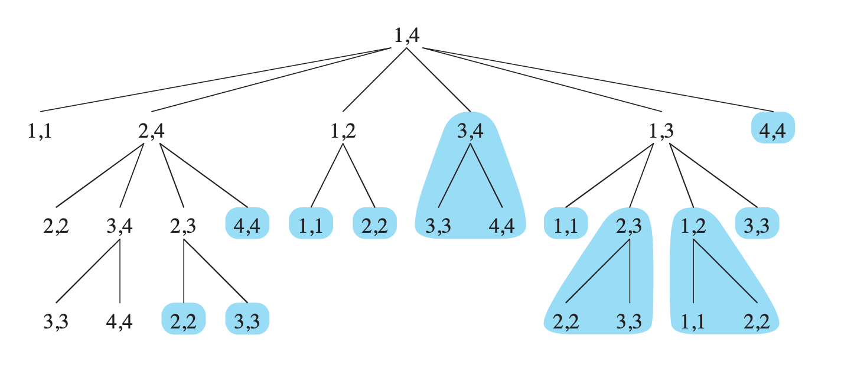
Elements of dynamic programming
Overlapping subproblems
The recursion tree for the computation of RECURSIVE-MATRIX-CHAIN(p, 1, 4). Each node contains the parameters i and j.
The computations performed in a subtree shaded blue are replaced by a single table lookup in MEMOIZED-MATRIX-CHAIN

Slide 22

Elements of dynamic programming
Overlapping subproblems
$T\left(n\right)≥$
We can prove that T(n) =Ω(2^{n}) using substitution method.

Slide 23
Elements of dynamic programming
Reconstructing optimal solution
As we can see from rod cutting problem, there are 2 approaches to dynamic programming:
Bottom-up strategy.
Memoized top-down strategy.

Slide 24
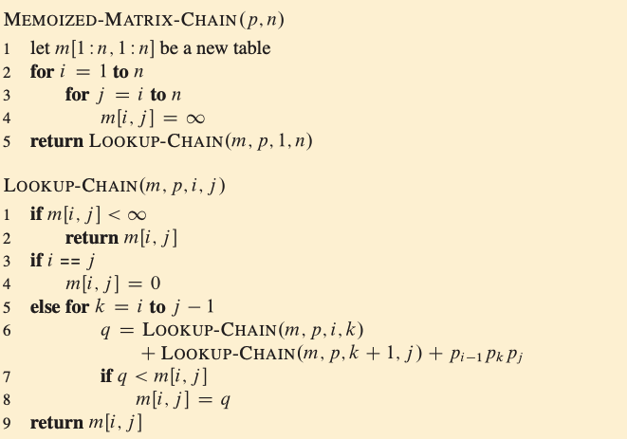
Elements of dynamic programming
Reconstructing optimal solution

Slide 25

Summary
We have seen how to solve the matrix-chain multiplication problem by either a top-down, memoized dynamic-programming or a bottom-up dynamic-programming in $O(n^{3})$ time.
Both the bottom-up and memoized meth- ods take advantage of the overlapping-subproblems property.
However, in general practice, if all subproblems must be solved at least once, a bottom-up algorithm usually outperforms the corresponding top-down memorized algorithm by constant factor.
On the other hand, in certain situations, some of the subproblems in the subproblem space might not need to be solved at all.
In that case, the memoized solution has the advantage of solving only those subproblems that are definitely required.

Slide 26
Exercises
16
After you learn how Dynamic Programming works, now let’s compare it with Greedy approach. Design algorithms for the Fractional Knapsack and 0-1 Knapsack using Dynamic Programming. Compare the running time of the algorithms with greedy approach. Which is better? Why?
Which is a more efficient way to determine the optimal number of multiplications in a matrix-chain multiplication problem: enumerating all the ways of parenthesizing the product and computing the number of multiplications for each, or running RECURSIVE-MATRIX-CHAIN? Justify your answer.

Slide 27
Exercises
16
Consider the antithetical variant of the matrix-chain multiplication problem where the goal is to parenthesize the sequence of matrices so as to maximize, rather than minimize, the number of scalar multiplications. Does this problem exhibit optimal substructure?

Slide 28
References
Thomas H. Cormen. (2022). Introduction to algorithms: Fourth edition. The MIT Press. Chapter 14.
https://web.stanford.edu/class/archive/cs/cs161/cs161.1168/lecture12.pdf

Slide 29
Thank you
Dynamic programming: Matrix Chain Multiplication
September, 2023

